Slide 1

In the beginning…
There were servers

Slide 2
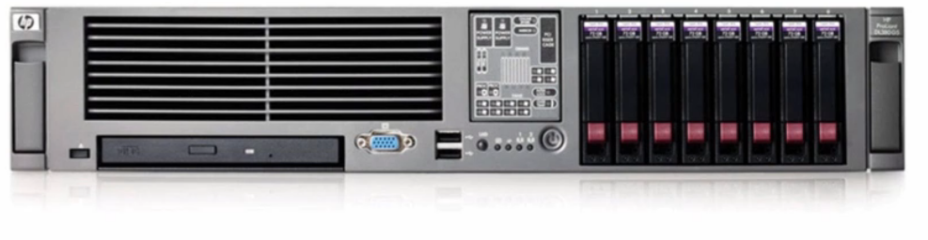
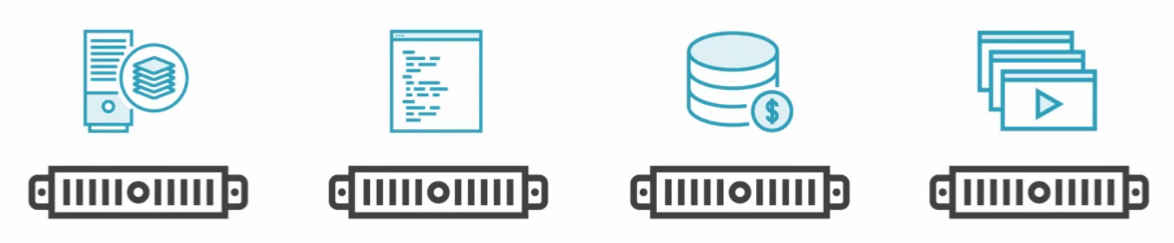
You required hardware to run your different services
A physical box for…
Web server
Database
Proxy
Firewall
Monitoring/Telemetry (Syslog)
Terminal

Slide 3
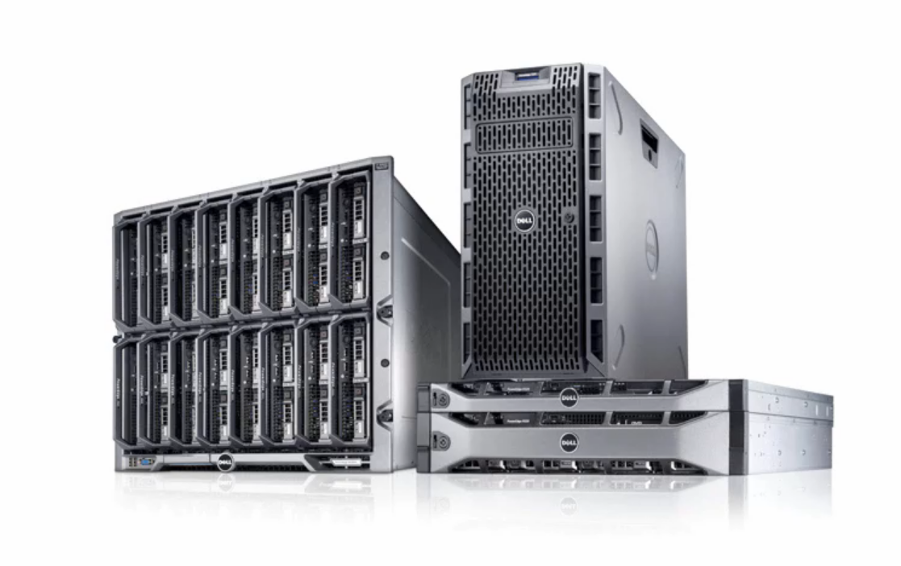
Upfront capex cost
Ongoing opex cost
Powering
Maintain
Installation
Securing
Replaceing

Slide 4
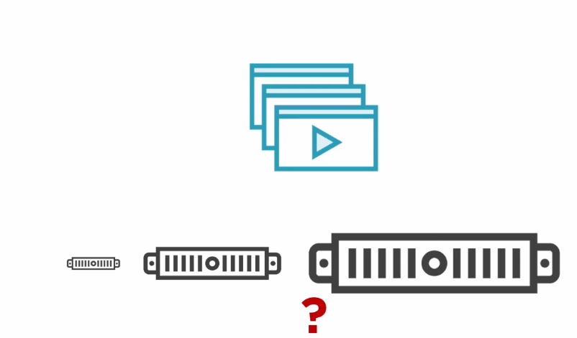
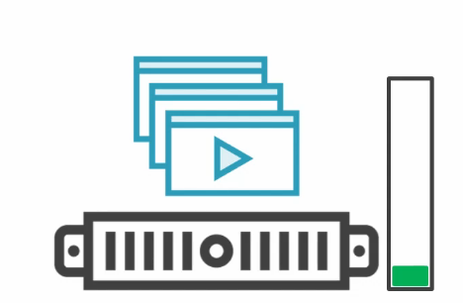
Which hardware should you buy???
Nobody knew how big or fast a server needed to be.
You always needed to accommodate PEAK load. Even if it was only once or twice a year
As a result, business Usually had severely over-provisioned servers sitting at only 5%-10% utilization

Slide 5
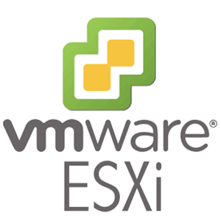
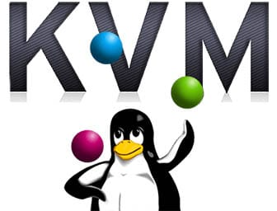
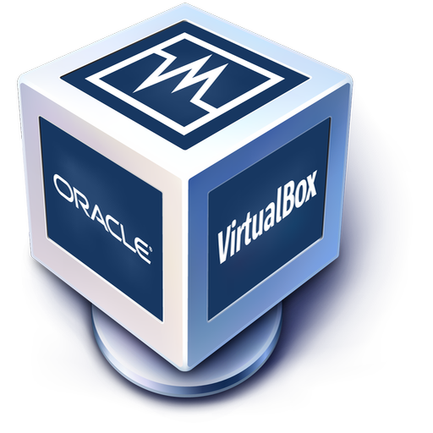
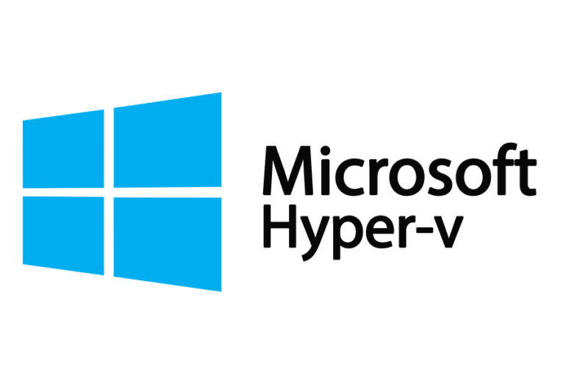
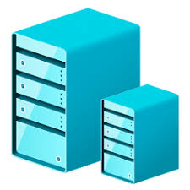
Then there came virtualization
Now you have one hoss of a box
You use a hypervisor
Type 1 = runs directly on the system hardware. “Bare Metal” embedded
VSXi
Type 2 = runs on the host operating system that provides virt services
Hyper-V (Windows)
KVM (Linux)
Oracle VirtualBox
VMWare Desktop

Slide 6
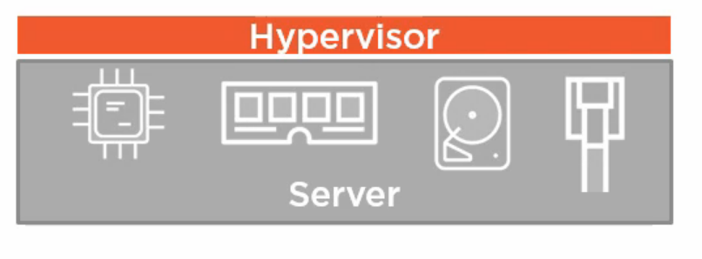
Hypervisors divide up physical server resources
Processor Registers
Memory Addressing
Disk Space

Slide 7
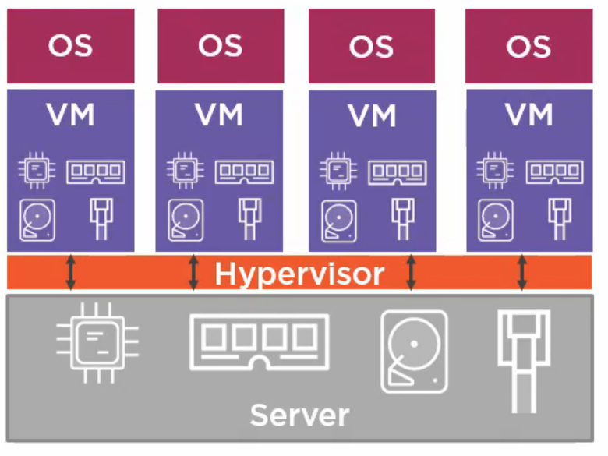

Slide 8
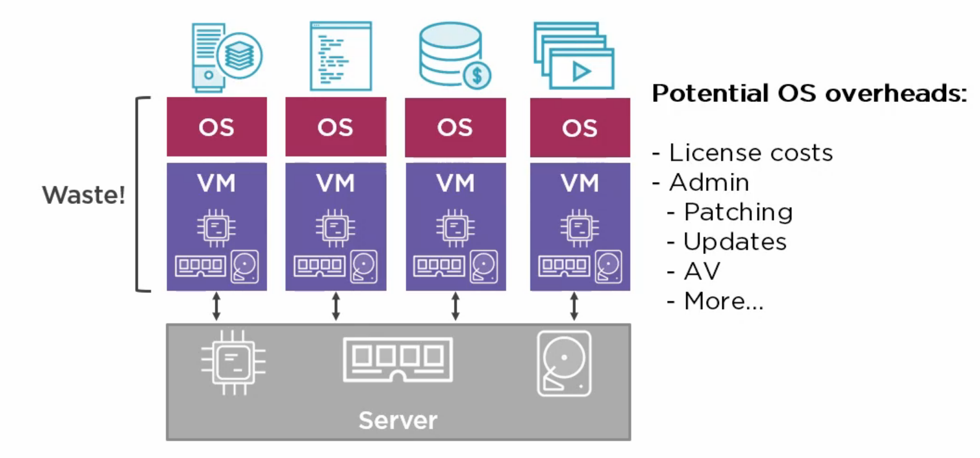

Slide 9

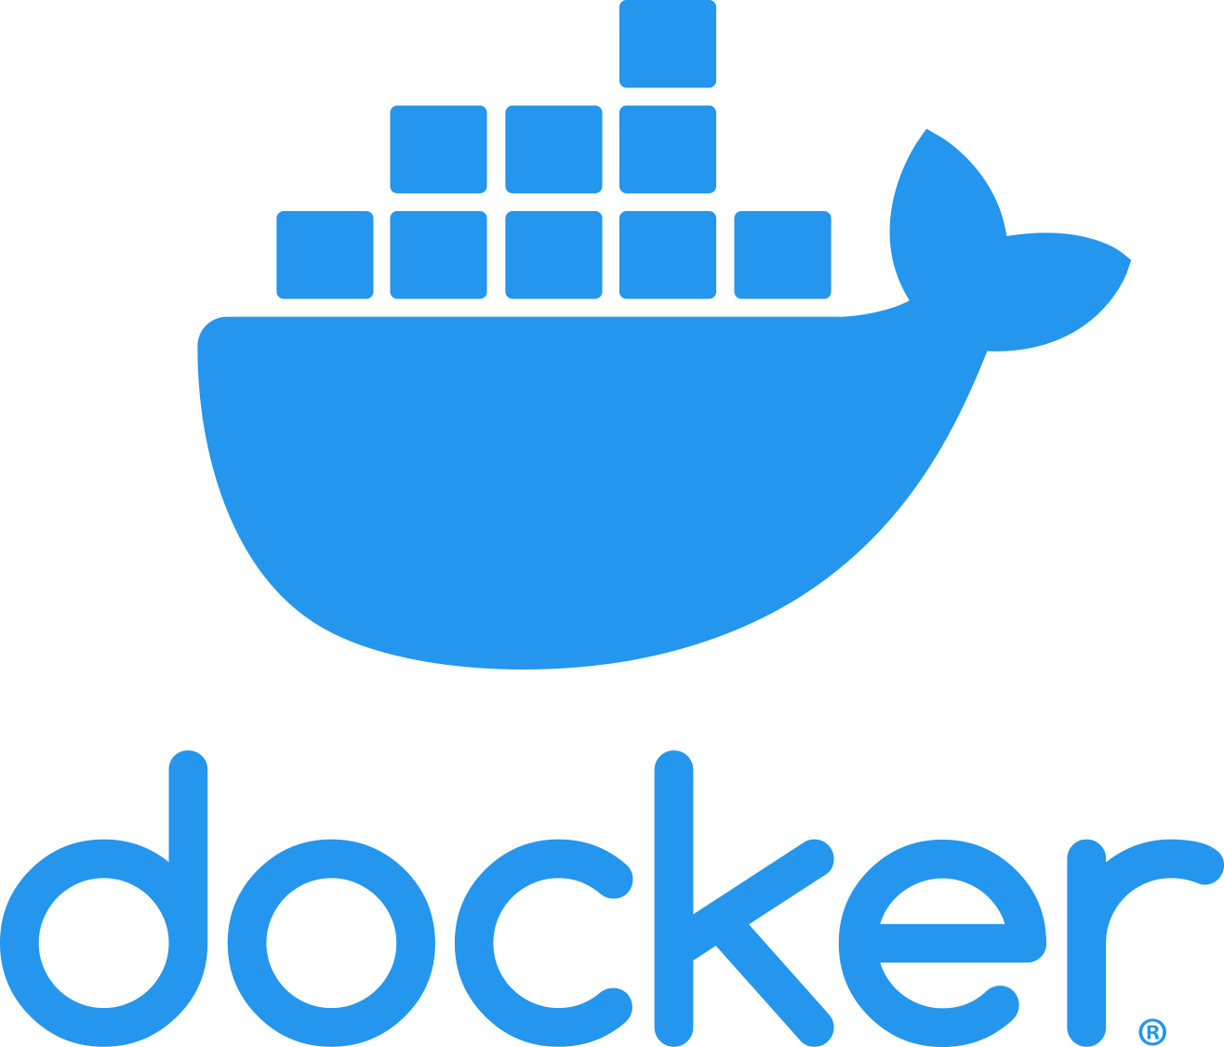
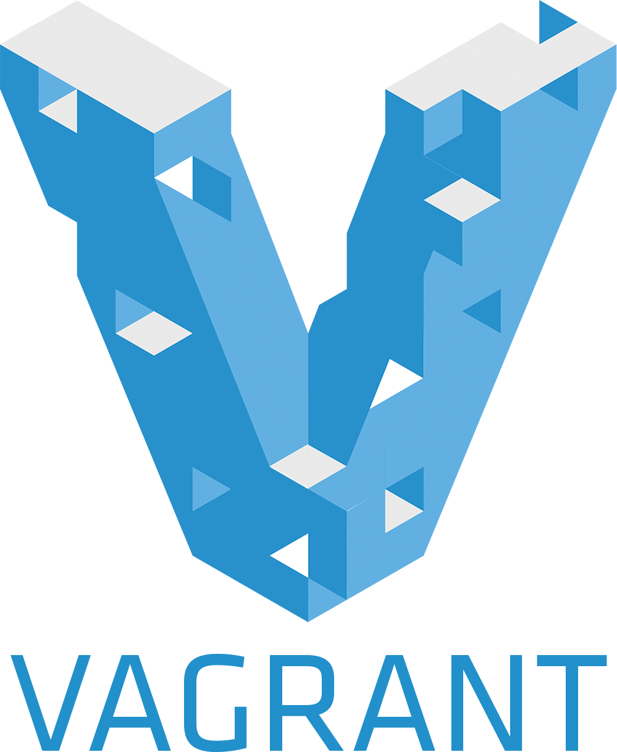
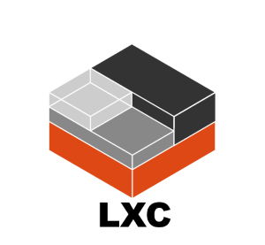
Now we have containers
Containers are like processes. They run like applications
There is a single operating system running all the containers that are scheduled to a single piece of physical hardware
No “boot up” time for containers
Smaller attack surface
Packaged dependencies (no additional installations)

Slide 10
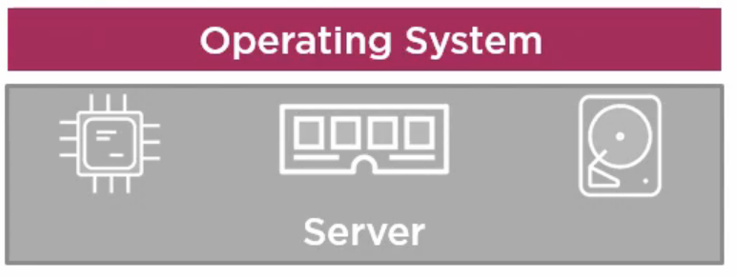

Slide 11
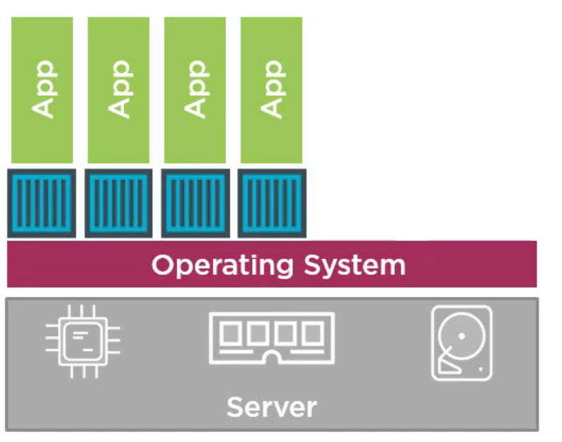

Slide 12
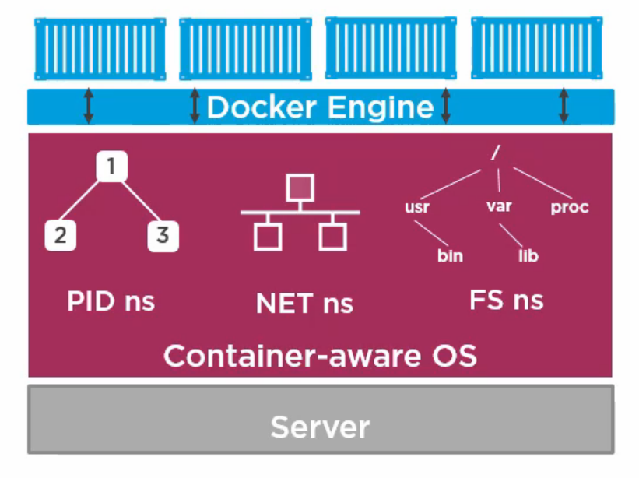
Containers divide up Operating System Resources
Processor Interrupts
Networking Namespace
Filesystem

Slide 13
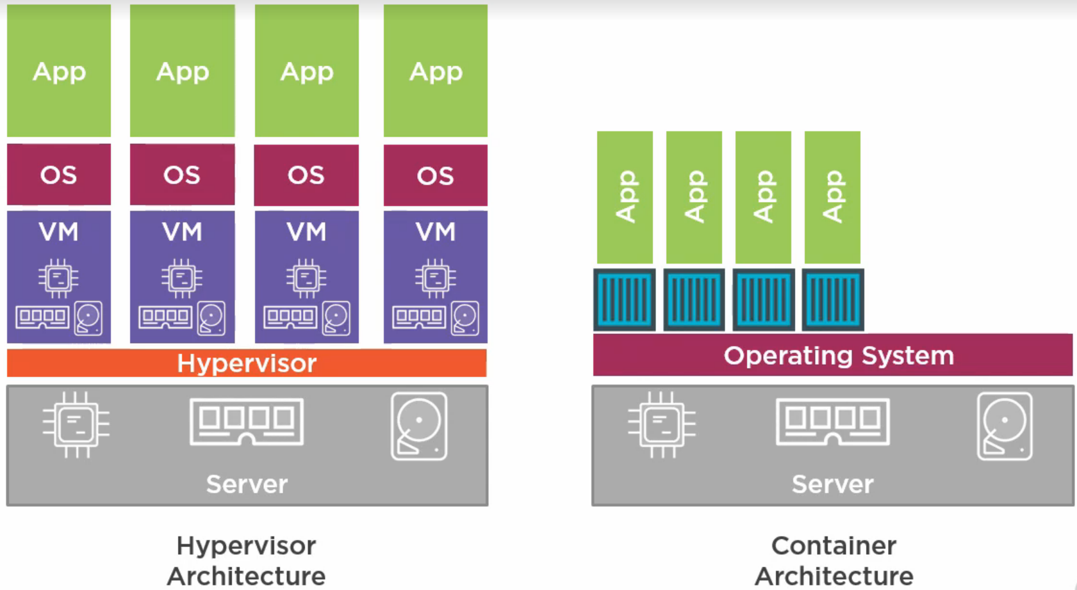

Slide 14
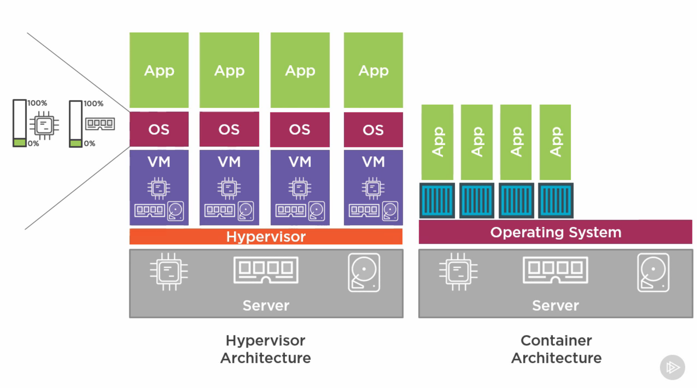

Slide 15
Images vs Containers
An Image is a pre-packed application
You can build one from scratch
You can build on top of existing images
You can download from repositories
DockerHub
ECR
Harbor
A container is a running instance of an image. You can assign it a name and expose it on a network port
An example image would be a packaged webserver with content for that webserver to display and a command to get that web server running and configured.

Slide 16
